Slide 1
CYBR 520
Chapter 1: Exploratory Data Analysis Fundamentals
Hands-On Exploratory Data Analysis with Python: Perform EDA techniques to understand, summarize, and investigate your data.

Slide 2
TOPICS
Understanding data science
The significance of EDA
Making sense of data
Comparing EDA with classical and Bayesian analysis
Software tools available for EDA
Getting started with EDA

Slide 3
Objectives
In this chapter, we are going to learn and revise the following topics:
Understanding data science
The significance of EDA
Making sense of data
Comparing EDA with classical and Bayesian analysis
Software tools available for EDA
Getting started with EDA

Slide 4
Exploratory Data Analysis Fundamentals
We are surrounded with data
Data encompasses a collection of discrete objects, numbers, words, events, facts, measurements, observations, or even descriptions of things.
every event or process occurring in several disciplines, including biology, economics, engineering, marketing, and others

Slide 5
Exploratory Data Analysis Fundamentals
Processing such data elicits useful information and processing such information generates useful knowledge.
But an important question is: how can we generate meaningful and useful information from such data?

Slide 6
Exploratory Data Analysis Fundamentals
An answer to this question is EDA.
EDA is a process of examining the available dataset to discover patterns, spot anomalies, test hypotheses, and check assumptions using statistical measures.
In this chapter, we are going to discuss the steps involved in performing top-notch exploratory data analysis and get our hands dirty using some open source databases.

Slide 7
Understanding data science

Slide 8
The Essentials of Data Science
Data science is currently a hot topic, and it's evolving rapidly.
The role of data scientists is changing – it's not just about building models anymore.
Data science is at its peak in terms of popularity and demand.
Skills required for data scientists are constantly evolving.
We now expect data scientists to not only build models but also explain and utilize results for business intelligence

Slide 9
Skillset for Data Scientists
People often ask, "What skills do I need to become a top-notch data scientist?"
Contrary to popular belief, you don't necessarily need a Ph.D. in data science.
Data science requires cross-disciplinary knowledge in computer science, data, statistics, and mathematics.

Slide 10
Phases of Data Analysis
Data Requirements
Data Collection
Data Processing
Data Cleaning
Exploratory Data Analysis
Modeling and Algorithms
Data Product and Communication

Slide 11
Data Requirements
It is important to comprehend what type of data is required for the organization to be collected, curated, and stored.
All of these data points are required to correctly tackle the problem (e.g., health, cyber, etc…)
Hence, these are mandatory requirements for the application.
It is required to categorize the data, numerical or categorical, and the format of storage and dissemination.

Slide 12
2. Data Collection
Data collected from several sources must be stored in the correct format and transferred to the right information technology personnel within a company.
As mentioned previously, data can be collected from several objects on several events using different types of sensors and storage tools.

Slide 13
3. Data processing
Preprocessing involves the process of pre-curating the dataset before actual analysis.
Common tasks involve correctly exporting the dataset, placing them under the right tables, structuring them, and exporting them in the correct format

Slide 14
4. Data cleaning
Preprocessed data is not yet ready for detailed analysis.
It must undergo several transformations to ensure data quality.
Data cleaning is a vital stage that involves:
Checking for incompleteness
Identifying and removing duplicates
Detecting errors
Handling missing values
Identifying data anomalies requires analytical techniques.
Data cleaning's approach varies depending on the dataset types.
For instance, quantitative data cleaning may involve outlier detection methods.

Slide 15
5. Exploratory Data Analysis
The stage where we actually start to understand the message contained in the data.
Several types of data transformation techniques might be required during the process of exploration.
We will cover descriptive statistics in-depth in Section 2, Chapter 5, Descriptive Statistics, to understand the mathematical foundation behind descriptive statistics.

Slide 16
6. Modeling and Algorithms
In data science, models and mathematical formulas represent relationships among variables.
These models involve variables that depend on others to cause an event.
Models describe relationships between independent and dependent variables.
Inferential statistics quantifies these relationships.

Slide 17
Example
Total Price of Pens (Total) = Unit Price (UnitPrice) * Quantity Bought (Quantity)
=> Model: Total = UnitPrice * Quantity
Dependent Variable: Total Price (Depends on Unit Price)
Independent Variable: Unit Price

Slide 18
7. Data Product
Software that uses data
Gives outputs
Uses feedback to control things
Intrusion Detection System (IDS)
Inputs: Network Traffic Data
Output: Alerts on Suspicious Activities

Slide 19
8. Communication
This stage deals with disseminating the results to end stakeholders to use the result for business intelligence.
One of the most notable steps in this stage is data visualization.
Visualization deals with information relay techniques such as tables, charts, summary diagrams, and bar charts to show the analyzed result.

Slide 20
The significance of eda

Slide 21
The significance of EDA
Different fields rely on electronic databases to store data.
Effective decision-making requires extracting insights from large datasets.
Computer programs are essential for analyzing datasets with numerous data points.
Data mining is the process of extracting valuable insights from data.

Slide 22
The significance of EDA
Exploratory Data Analysis (EDA) is a crucial first step in data mining.
EDA helps visualize data, create hypotheses, and understand its content.
EDA uncovers ground truth without making assumptions.
Key components of EDA include data summarization, statistical analysis, and visualization.
Python offers powerful tools for EDA, such as pandas, scipy, matplotlib, and plotly.

Slide 23
Steps in EDA
Problem definition
Data preparation
Data analysis
Development and representation of the results

Slide 24
1. Problem definition
Before trying to extract useful insight from the data, it is essential to define the business problem to be solved.
The problem definition works as the driving force for a data analysis plan execution.

Slide 25
1. Problem definition- Tasks
Defining the main objective of the analysis
Defining the main deliverables
Outlining the main roles and responsibilities
Obtaining the current status of the data,
Defining the timetable
Performing cost/benefit analysis.
Based on such a problem definition, an execution plan can be created.

Slide 26
2. Data preparation
Define the sources of data
Define data schemas and tables
Understand the main characteristics of the data
Clean the dataset
Delete non-relevant datasets
Transform the data
Divide the data into required chunks for analysis.

Slide 27
3. Data analysis
This is one of the most crucial steps that deals with descriptive statistics and analysis of the data.
Summarize the data
Finding the hidden correlation and relationships among the data
Developing predictive models
Evaluating the models and calculating the accuracies.
Some of the techniques used for data summarization are summary tables, graphs, descriptive statistics, inferential statistics, correlation statistics, searching, grouping, and mathematical models.

Slide 28
4. Development and representation of the results
Presenting the dataset to the target audience in the form of graphs, summary tables, maps, and diagrams.
The result analyzed from the dataset should be interpretable by the business stakeholders, which is one of the major goals of EDA.
Most of the graphical analysis techniques include scattering plots, character plots, histograms, box plots, residual plots, mean plots, and others. We will explore several types of graphical representation in

Slide 29
Making sense of data
It is crucial to identify the type of data under analysis.
For example, medical researchers store patients' data, universities store students' and teachers' data, and real estate industries storehouse and building datasets.
A dataset contains many observations about a particular object.

Slide 30
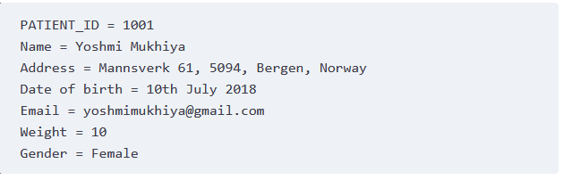
Making sense of data
For instance, a dataset about patients in a hospital can contain many observations. A patient can be described by a patient identifier (ID), name, address, weight, date of birth, address, email, and gender.
Each of these features that describes a patient is a variable. Each observation can have a specific value for each of these variables. For example, a patient can have the information provided above:

Slide 31
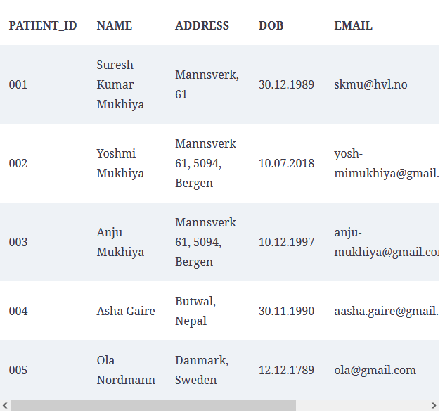
Making sense of data
These datasets are stored in hospitals and are presented for analysis. Most of this data is stored in some sort of database management system in tables/schema.
An example of a table for storing patient information is shown in the Figure

Slide 32
Making sense of data
To summarize the preceding table, there are four observations (001, 002, 003, 004, 005).
Each observation describes variables (PatientID, name, address, dob, email, gender, and weight).
Most of the dataset broadly falls into two groups:
Numerical data
Categorical data

Slide 33
1. Numerical data
This data has a sense of measurement involved in it;
a person's age, height, weight, blood pressure, heart rate, temperature, number of teeth, number of bones, and the number of family members.
This data is often referred to as quantitative data in statistics. The numerical dataset can be either:
discrete
continuous

Slide 34
1.a. Discrete Data
This is data that is countable and its values can be listed out.
For example, if we flip a coin, the number of heads in 200 coin flips can take values from 0 to 200 (finite) cases.
A variable that represents a discrete dataset is referred to as a discrete variable.

Slide 35
1.a. Discrete Data/ Example
The discrete variable takes a fixed number of distinct values.
For example, the Country variable can have values such as Nepal, India, Norway, and Japan. It is fixed.
The Rank variable of a student in a classroom can take values from 1, 2, 3, 4, 5, and so on.

Slide 36
1.b. Continuous data
A variable that can have an infinite number of numerical values within a specific range is classified as continuous data.
A variable describing continuous data is a continuous variable.
Continuous data can follow two scales:
Interval measure of scale
Ratio measure of scale

Slide 37
1.b. Continuous data / Example
What is the temperature of your city today?
Can we be finite?
Similarly, the weight variable in the previous section is a continuous variable.

Slide 38
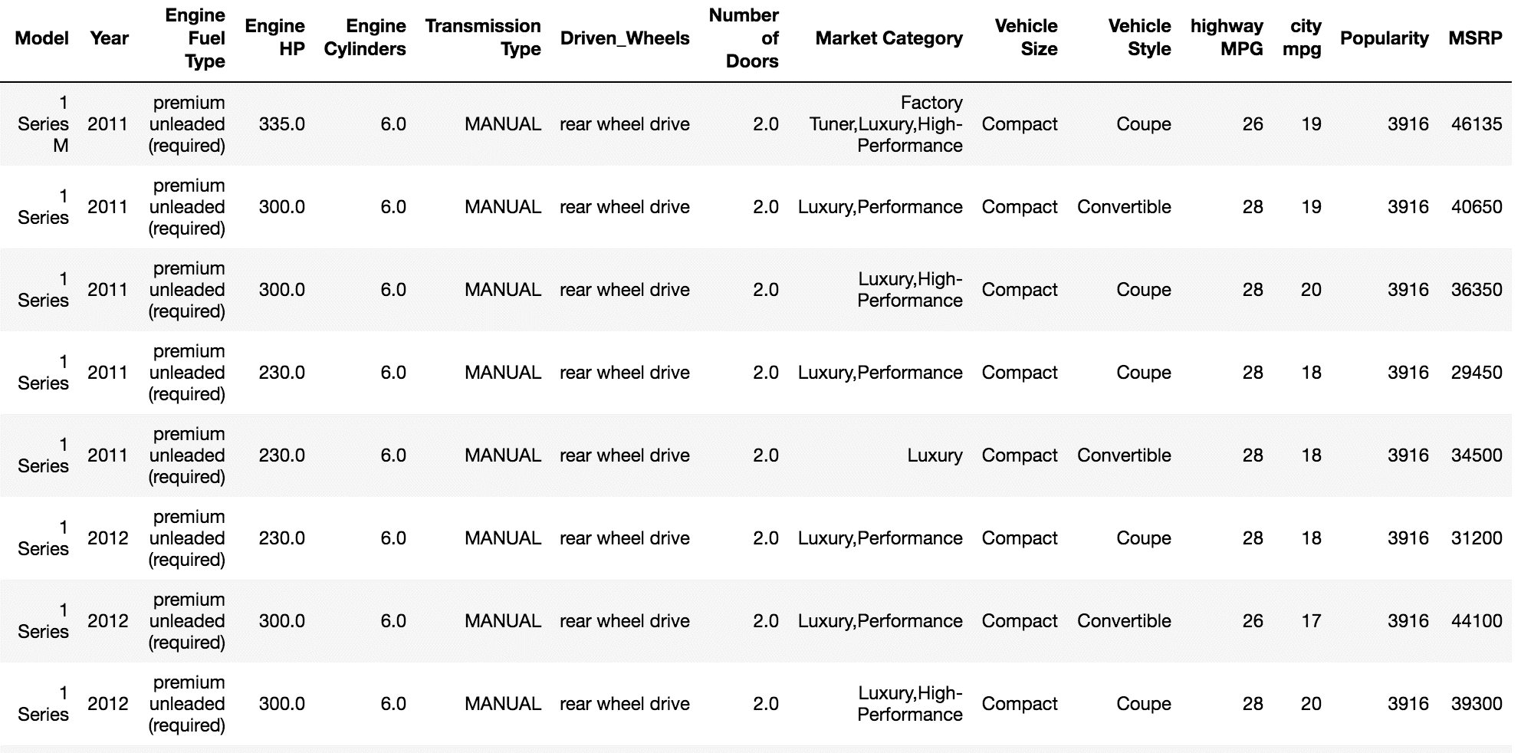
Question
Given the car dataset (available on GitHub), identify the data type of each column.

Slide 39
2. Categorical data
This data is often referred to as qualitative datasets in statistics.
This type of data represents the characteristics of an object;
Gender
Marital status
Type of address
Categories of the movies

Slide 40
2. Categorical data
A variable describing categorical data is referred to as a categorical variable.
These types of variables can have one of a limited number of values.
Also known as enumerated types or enumerations of variables.
Two types of categorical variables:
Binary categorical
Polytomous variables

Slide 41
2.a. Binary Categorical
A binary categorical variable can take exactly two values and is also referred to as a dichotomous variable.
For example, when you create an experiment, the result is either success or failure.
Hence, results can be understood as a binary categorical variable.

Slide 42
2.a. Polytomous variables
Categorical variables that can take more than two possible values.
For example, marital status can have several values, such as annulled, divorced, interlocutory, legally separated, married, polygamous, never married, domestic partners, unmarried, widowed, domestic partner, and unknown.
Since marital status can take more than two possible values, it is a polytomous variable.

Slide 43
2. Categorical data/ Examples
Gender (Male, Female, Other, or Unknown)
Marital Status (Annulled, Divorced, Interlocutory, Legally Separated, Married, Polygamous, Never Married, Domestic Partner, Unmarried, Widowed, or Unknown)
Movie genres (Action, Adventure, Comedy, Crime, Drama, Fantasy, Historical, Horror, Mystery, Philosophical, Political, Romance, Saga, Satire, Science Fiction, Social, Thriller, Urban, or Western)
Blood type (A, B, AB, or O)
Types of drugs (Stimulants, Depressants, Hallucinogens, Dissociatives, Opioids, Inhalants, or Cannabis)

Slide 44
Most of the categorical datasets follow either
Nominal measurement scales
Ordinal measurement scales

Slide 45
Measurement scales
There are four different types of measurement scales described in statistics:
Nominal
Ordinal
Interval
Ratio

Slide 46
Nominal Measurement Scale
These are practiced for labeling variables without any quantitative value.
The scales are generally referred to as labels.
And these scales are mutually exclusive and do not carry any numerical importance.
Order is irrelevant!

Slide 47
Nominal Measurement Scale
Nominal scales are considered qualitative scales and the measurements that are taken using qualitative scales are considered qualitative data.
Do not be confused, they are not quantitative
If, someone uses numbers as labels in the nominal measurement sense, they have no concrete numerical value or meaning.
No form of arithmetic calculation can be made on nominal measures.

Slide 48
Nominal Measurement Scale/ Example
What is your gender?
Male
Female
Third gender/Non-binary
I prefer not to answer
Other
Other examples include the following:
The languages that are spoken in a particular country
Biological species
Parts of speech in grammar (noun, pronoun, adjective, and so on)
Taxonomic ranks in biology (Archea, Bacteria, and Eukarya)

Slide 49
Why do we care about Measurements Scales?
You might be thinking why should you care about whether data is nominal or ordinal? Should we not just start loading the data and begin our analysis? Well, we could.
But think about this: you have a dataset, and you want to analyze it.
How will you decide whether you can make a pie chart, bar chart, or histogram?
Are you getting my point?

Slide 50
What can we do with Nominal dataset?
Frequency is the rate at which a label occurs over a period of time within the dataset.
Proportion can be calculated by dividing the frequency by the total number of events.
Then, you could compute the percentage of each proportion.
And to visualize the nominal dataset, you can use either a pie chart or a bar chart.

Slide 51
Ordinal Measurement Scale
The main difference in the ordinal and nominal scale is the order.
In ordinal scales, the order of the values is a significant factor.
To make it easier, consider ordinal scales as an order of ranking (1st, 2nd, 3rd, 4th, and so on).
The median item is allowed as the measure of central tendency; however, the average is not permitted.
Likert scale

Slide 52
Likert scale
A Likert scale is a widely used method for measuring attitudes, opinions, and perceptions in surveys and research.
It provides respondents with a range of response options to express their level of agreement or disagreement with a statement.

Slide 53
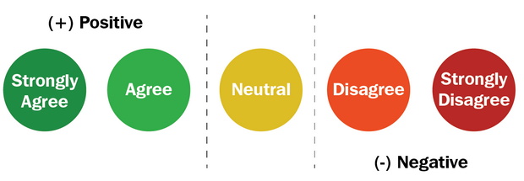
Likert scale- Example1
WordPress is making content managers' lives easier. How do you feel about this statement?

Slide 54
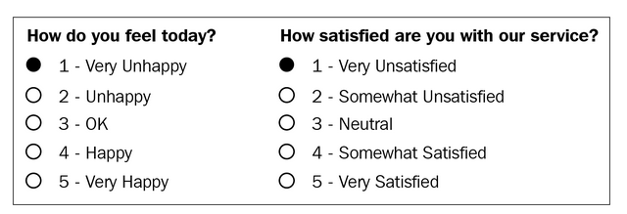
Likert scale- Example2
WordPress is making content managers' lives easier. How do you feel about this statement?

Slide 55
Interval Measurements Scale
In interval scales, both the order and exact differences between the values are significant. Interval scales are widely used in statistics, for example, in the measure of central tendencies—mean, median, mode, and standard deviations.
Examples include location in Cartesian coordinates and direction measured in degrees from magnetic north.
The mean, median, and mode are allowed on interval data.

Slide 56
Ratio Measurements Scale
Ratio scales contain order, exact values, and absolute zero, which makes it possible to be used in descriptive and inferential statistics.
These scales provide numerous possibilities for statistical analysis.
Mathematical operations, the measure of central tendencies, and the measure of dispersion and coefficient of variation can also be computed from such scales.

Slide 57
Ratio Measurements Scale
Examples include a measure of energy, mass, length, duration, electrical energy, plan angle, and volume.

Slide 58
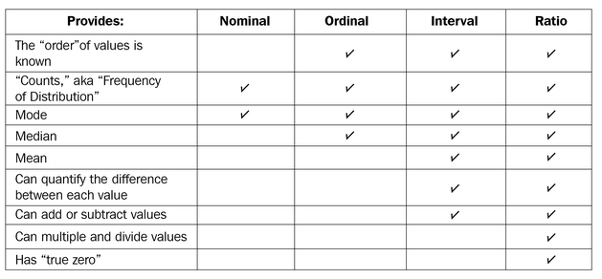
Scales/ Summary

Slide 59
Comparing EDA with classical and Bayesian analysis
There are several approaches to data analysis.
The most popular ones that are relevant to us are the following:
Classical data analysis
Exploratory data analysis approach (EDA)*
Bayesian data analysis approach

Slide 60
Classical data analysis
For the classical data analysis approach, the problem definition and data collection step are followed by model development, which is followed by analysis and result communication.

Slide 61
Exploratory data analysis approach
For the EDA approach, it follows the same approach as classical data analysis except the model imposition and the data analysis steps are swapped.
The main focus is on the data, its structure, outliers, models, and visualizations.
Generally, in EDA, we do not impose any deterministic or probabilistic models on the data.

Slide 62
Bayesian data analysis approach
The Bayesian approach incorporates prior probability distribution knowledge into the analysis steps as shown in the following diagram.
Well, simply put, prior probability distribution of any quantity expresses the belief about that particular quantity before considering some evidence.

Slide 63
Software tools available for EDA
Python: This is an open source programming language widely used in data analysis, data mining, and data science (https://www.python.org/). For this book, we will be using Python.
R programming language: R is an open source programming language that is widely utilized in statistical computation and graphical data analysis (https://www.r-project.org).
Weka: This is an open source data mining package that involves several EDA tools and algorithms (https://www.cs.waikato.ac.nz/ml/weka/).
KNIME: This is an open source tool for data analysis and is based on Eclipse (https://www.knime.com/).

Slide 64
Python libraries for EDA
NumPy
Pandas
Matplotlib
SciPy

Slide 65
NumPy
Create arrays with NumPy, copy arrays, and divide arrays
Perform different operations on NumPy arrays
Understand array selections, advanced indexing, and expanding
Working with multi-dimensional arrays
Linear algebraic functions and built-in NumPy functions

Slide 66
pandas
Understand and create DataFrame objects
Sub-setting data and indexing data
Arithmetic functions, and mapping with pandas
Managing index
Building style for visual analysis

